Slide 1
Principles and Restrictions for One-site Real-space Basis Rotation on ftn58sparse
Feb, 2, 2021 洪逸群

Slide 2
$$new_ftn58sparse=rotateftn58_five(ftn58sparse,a,b,c,orbitype,orbital)$$
$$e.g. orbital=\left[1 2 3\right] with the correct order!$$

Slide 3
Principles

Slide 4
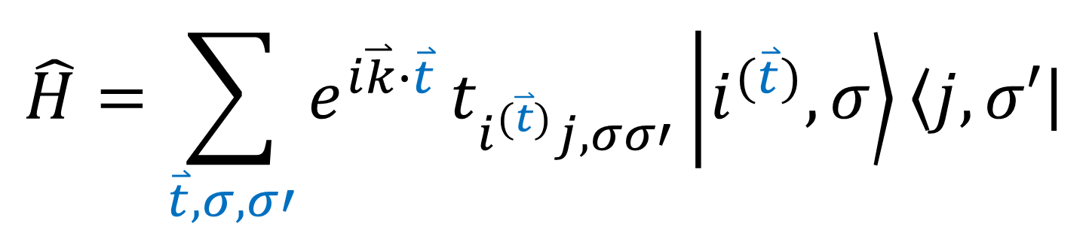
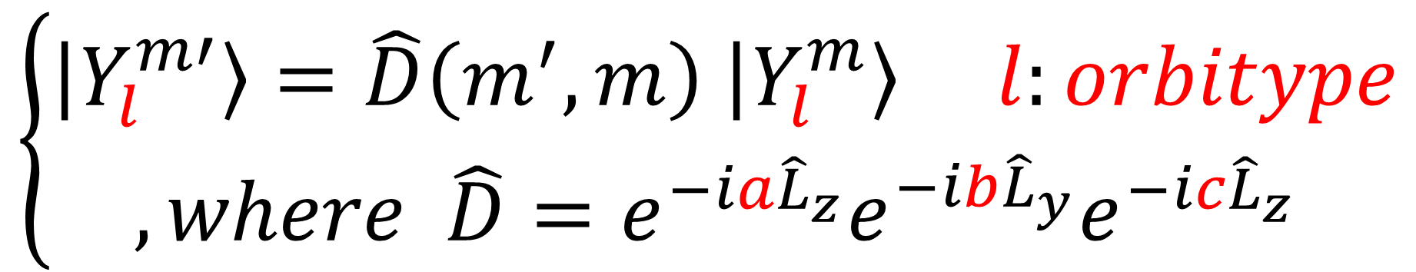
Summation convention is applied through out these PPT
$$\left\{\begin{aligned}\left|\left.Y_{l}^{m′}\right\rangle \right.=\hat{D}\left(m^{′},m\right) \left|\left.Y_{l}^{m}\right\rangle \right. l:orbitype \\ ,where \hat{D}=e^{−ia{\hat{L}}_{z}}e^{−ib{\hat{L}}_{y}}e^{−ic{\hat{L}}_{z}} \end{aligned}\right.$$
$$\hat{H}=\sum_{\overset{⃑}{t},σ,σ′}{e^{i\overset{⃑}{k}∙\overset{⃑}{t}}}t_{i^{(\overset{⃑}{t})}j,σσ′}\left|\left.i^{(\overset{⃑}{t})},σ\right\rangle \right.\left.\left\langle j\right.,σ′\right|$$

Slide 5
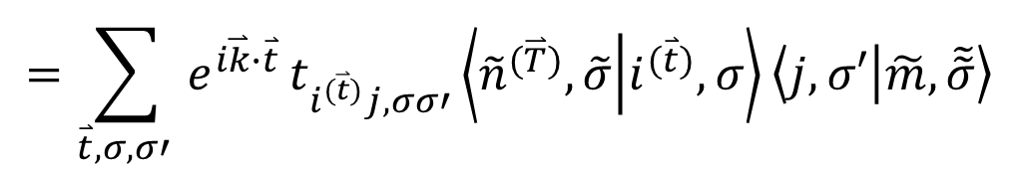
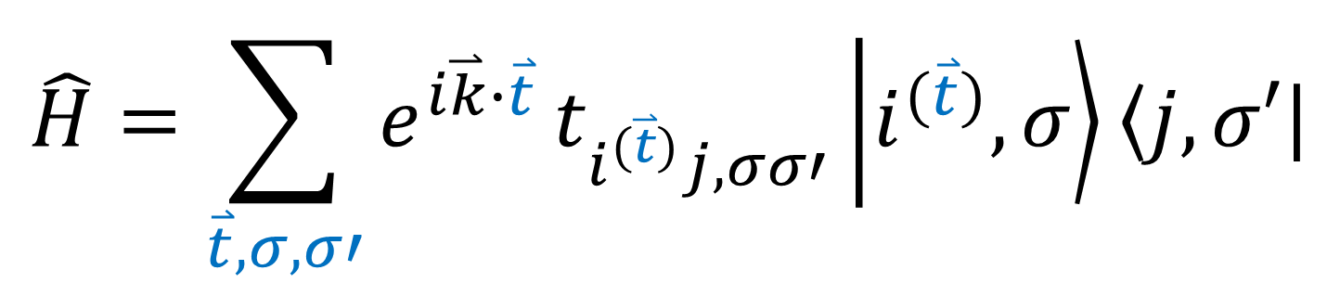
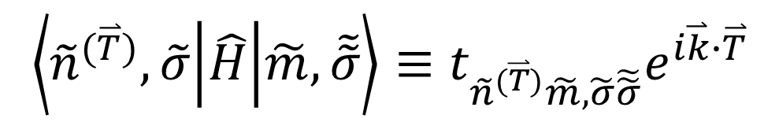
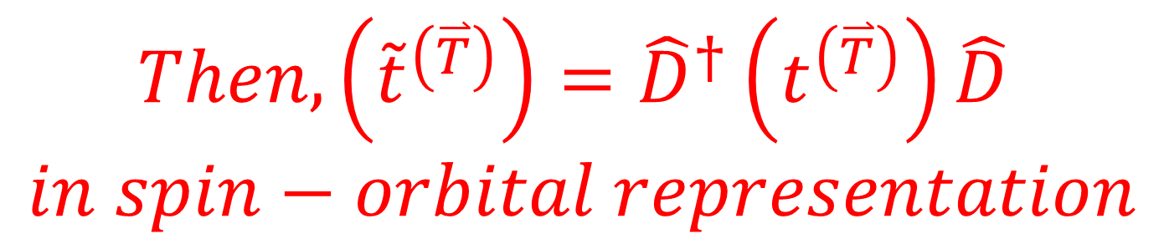
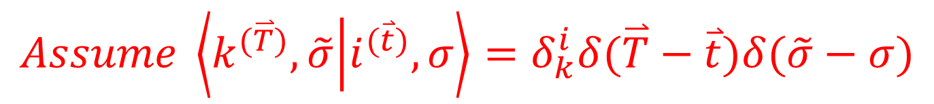
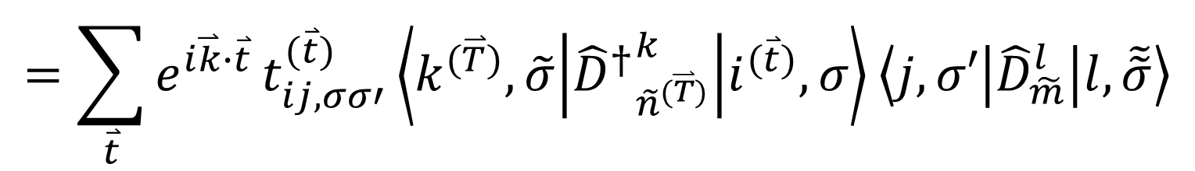
$$\hat{H}=\sum_{\overset{⃑}{t},σ,σ′}{e^{i\overset{⃑}{k}∙\overset{⃑}{t}}}t_{i^{(\overset{⃑}{t})}j,σσ′}\left|\left.i^{(\overset{⃑}{t})},σ\right\rangle \right.\left.\left\langle j\right.,σ′\right|$$
$$\left\langle {\tilde{n}}^{(\overset{⃑}{T})},\tilde{σ} | \hat{H} | \tilde{m},\tilde{\tilde{σ}}\right\rangle ≡t_{{\tilde{n}}^{(\overset{⃑}{T})}\tilde{m},\tilde{σ}\tilde{\tilde{σ}}}e^{i\overset{⃑}{k}∙\overset{⃑}{T}}$$
$$=\sum_{\overset{⃑}{t},σ,σ′ }{e^{i\overset{⃑}{k}∙\overset{⃑}{t}}}t_{i^{(\overset{⃑}{t})}j,σσ′}\left\langle {\tilde{n}}^{(\overset{⃑}{T})},\tilde{σ} | i^{(\overset{⃑}{t})},σ\right\rangle \left\langle j,σ′ | \tilde{m},\tilde{\tilde{σ}}\right\rangle$$
$$Assume \left\langle k^{(\overset{⃑}{T})},\tilde{σ} | i^{(\overset{⃑}{t})},σ\right\rangle =δ_{k}^{i}δ(\overset{⃑}{T}−\overset{⃑}{t})δ(\tilde{σ}−σ)$$
$$=\sum_{\overset{⃑}{t}}{e^{i\overset{⃑}{k}∙\overset{⃑}{t}}}t_{ij,σσ′}^{(\overset{⃑}{t})}\left\langle k^{(\overset{⃑}{T})},\tilde{σ} | {{\hat{D}}^{†}}_{{\tilde{n}}^{(\overset{⃑}{T})}}^{k} | i^{(\overset{⃑}{t})},σ\right\rangle \left\langle j,σ′ | {\hat{D}}_{\tilde{m}}^{l} | l,\tilde{\tilde{σ}}\right\rangle$$
$$Then, \left({\tilde{t}}^{\left(\overset{⃑}{T}\right)}\right)={\hat{D}}^{†}\left(t^{\left(\overset{⃑}{T}\right)}\right)\hat{D}$$
$$in spin−orbital representation$$

Slide 6


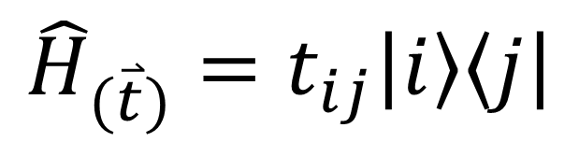



Summation convention is applied
$${\hat{H}}_{(\overset{⃑}{t})}=t_{ij}\left|\left.i\right\rangle \right.\left.\left\langle j\right.\right|$$
$$=t_{km}\left|\left.k\right\rangle \right.\left.\left\langle m\right.\right|+t_{im}\left|\left.i\right\rangle \right.\left.\left\langle m\right.\right|+t_{kj}\left|\left.k\right\rangle \right.\left.\left\langle j\right.\right|+t_{ij}\left|\left.i\right\rangle \right.\left.\left\langle j\right.\right|$$
$$①$$
$$②$$
$$③$$
$$④$$
$$\left(t\right)=\left(\begin{matrix}① & ③ & ① \\ ② & ④ & ② \\ ① & ③ & ①\end{matrix}\right)$$

Slide 7
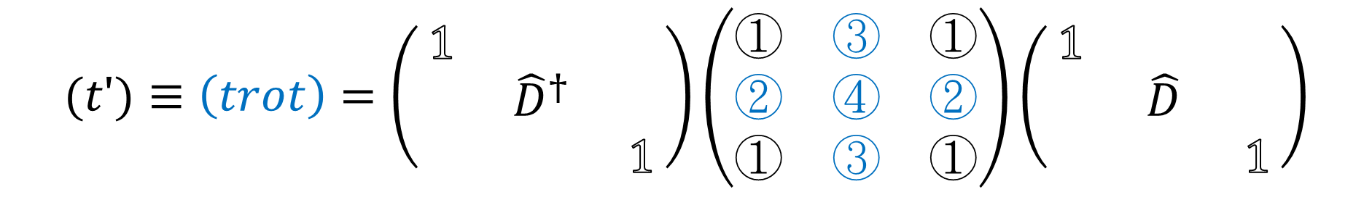
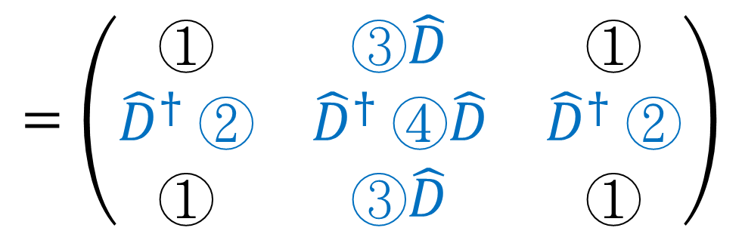
$$t_{km}\left|\left.k\right\rangle \right.\left.\left\langle m\right.\right|+t_{im}\left|\left.i\right\rangle \right.\left.\left\langle m\right.\right|+t_{kj}\left|\left.k\right\rangle \right.\left.\left\langle j\right.\right|+t_{ij}\left|\left.i\right\rangle \right.\left.\left\langle j\right.\right|$$
$$=t_{km}\left|\left.k\right\rangle \right.\left.\left\langle m\right.\right|+{t′}_{i^{′}m}\hat{D}\left|\left.i\right\rangle \right.\left.\left\langle m\right.\right|+{t′}_{kj^{′}}\left|\left.k\right\rangle \right.\left.\left\langle j\right.\right|{\hat{D}}^{†}+{t′}_{i^{′}j^{′}}\hat{D}\left|\left.i\right\rangle \right.\left.\left\langle j\right.\right|{\hat{D}}^{†}$$
$$(t′)≡\left(trot\right)=\left(\begin{matrix}1 & & \\ & {\hat{D}}^{†} & \\ & & 1\end{matrix}\right)\left(\begin{matrix}① & ③ & ① \\ ② & ④ & ② \\ ① & ③ & ①\end{matrix}\right)\left(\begin{matrix}1 & & \\ & \hat{D} & \\ & & 1\end{matrix}\right)$$
$$=\left(\begin{matrix}① & ③\hat{D} & ① \\ {\hat{D}}^{†} ② & {\hat{D}}^{†} ④\hat{D} & {\hat{D}}^{†} ② \\ ① & ③\hat{D} & ①\end{matrix}\right)$$

Slide 8
Restrictions

Slide 9
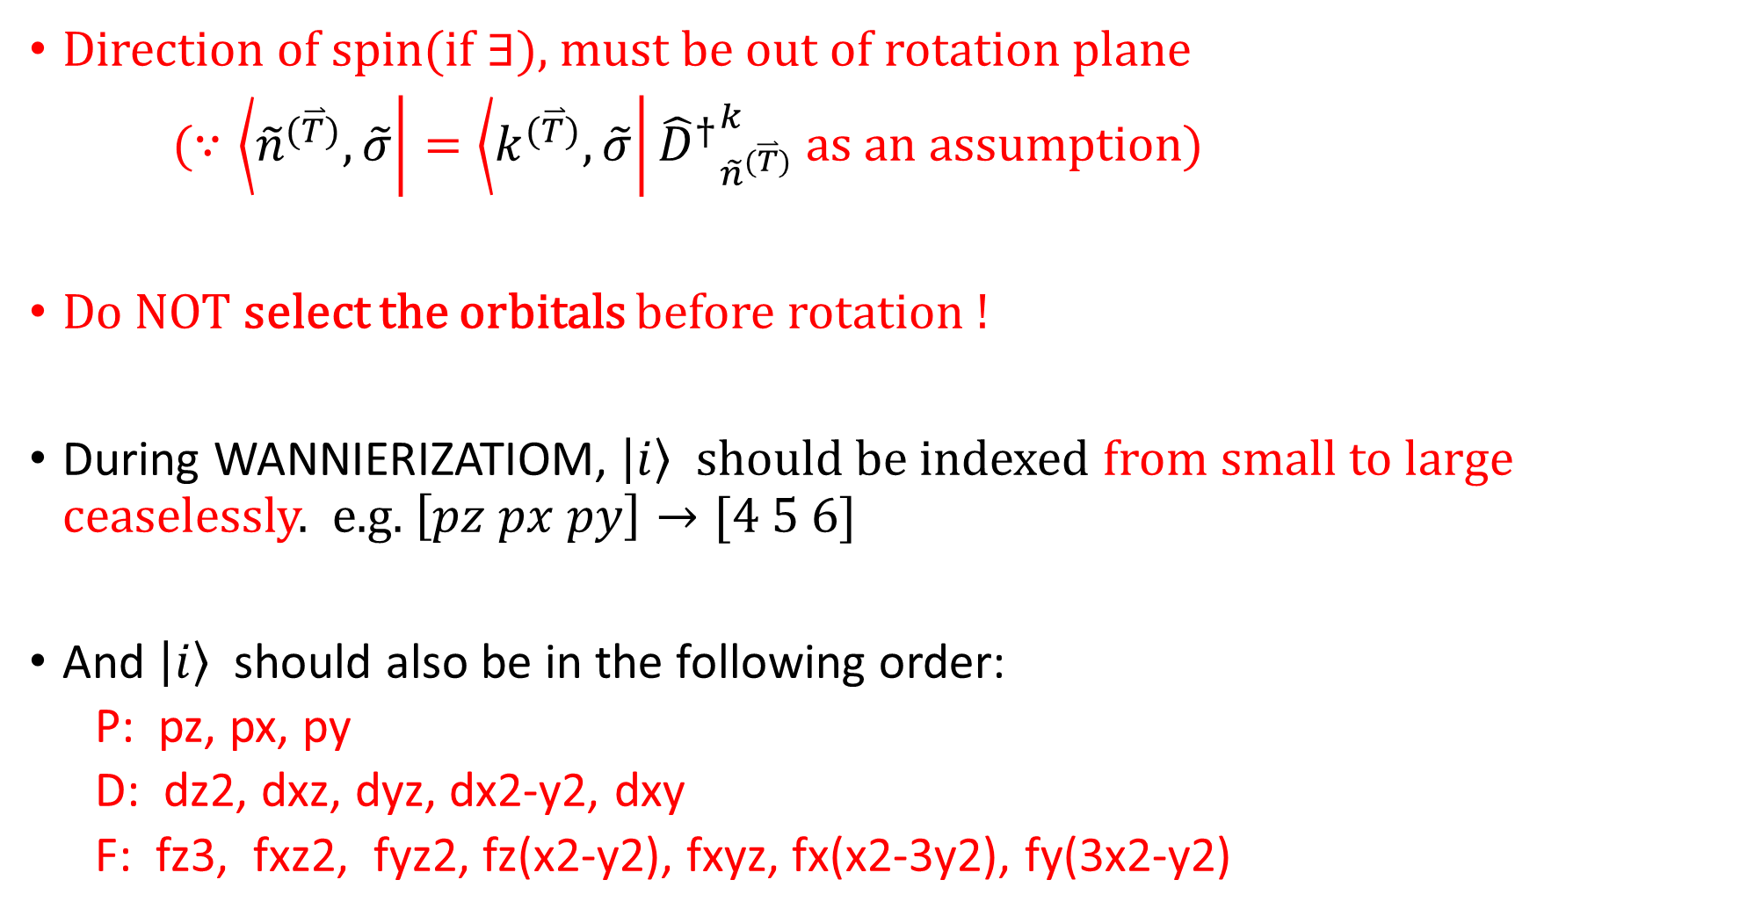
Direction of spin(if $∃$), must be out of rotation plane
($∵\left.\left\langle {\tilde{n}}^{(\overset{⃑}{T})},\tilde{σ}\right.\right|=\left.\left\langle k^{(\overset{⃑}{T})},\tilde{σ}\right.\right|{{\hat{D}}^{†}}_{{\tilde{n}}^{(\overset{⃑}{T})}}^{k}$ as an assumption)
Do NOT select the orbitals before rotation !
During WANNIERIZATIOM, $\left|\left.i\right\rangle \right.$ should be indexed from small to large ceaselessly. e.g. $\left[pz px py\right]→[4 5 6]$
And $\left|\left.i\right\rangle \right.$ should also be in the following order:
P: pz, px, py
D: dz2, dxz, dyz, dx2-y2, dxy
F: fz3, fxz2, fyz2, fz(x2-y2), fxyz, fx(x2-3y2), fy(3x2-y2)

Slide 10
Optional debug programs

Slide 11
debug_rotateftn58_five.m
The main program
Present the results that proves the rotation is legitimate
Please use it inside the directory ‘basis_rotation_five’ !

Slide 12
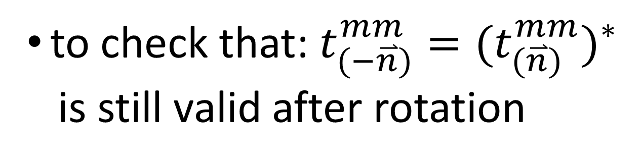
check_hopping_diagonal.m
to check that: $t_{(−\overset{⃑}{n})}^{mm}={(t_{(\overset{⃑}{n})}^{mm})}^{∗}$
is still valid after rotation

Slide 13
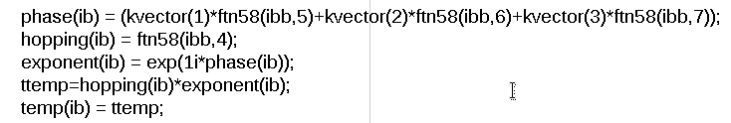
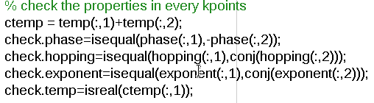
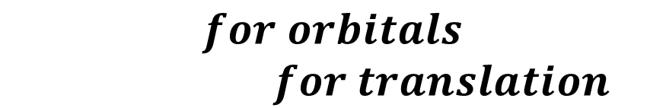
$$for orbitals$$
$for translation$

Slide 14
Other attached files support the aforementioned programs, as functions for calculations or as input data to debug.

